Slide 1

five decades of experience
EQIDIUS

Slide 2
five decades of experience
EQIDIUS
WHAT ALL THE GENERALS OF THE WORLD have failed to do, ONE BREED HAS ARCHIVED – to conquer the world

Slide 3
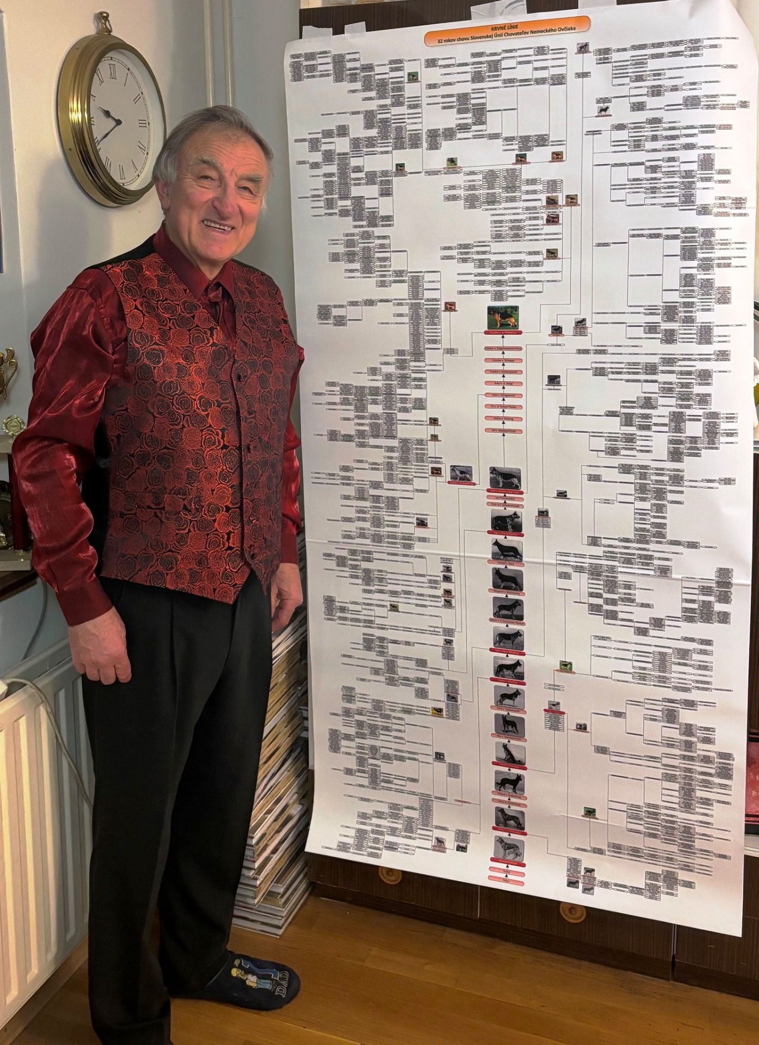
five decades of experience
EQIDIUS
50+ YEARS OF HARD-EARNED EXPERIENCE, distilled into one book
WHAT ALL THE GENERALS OF THE WORLD have failed to do, ONE BREED HAS ARCHIVED – to conquer the world

Slide 4
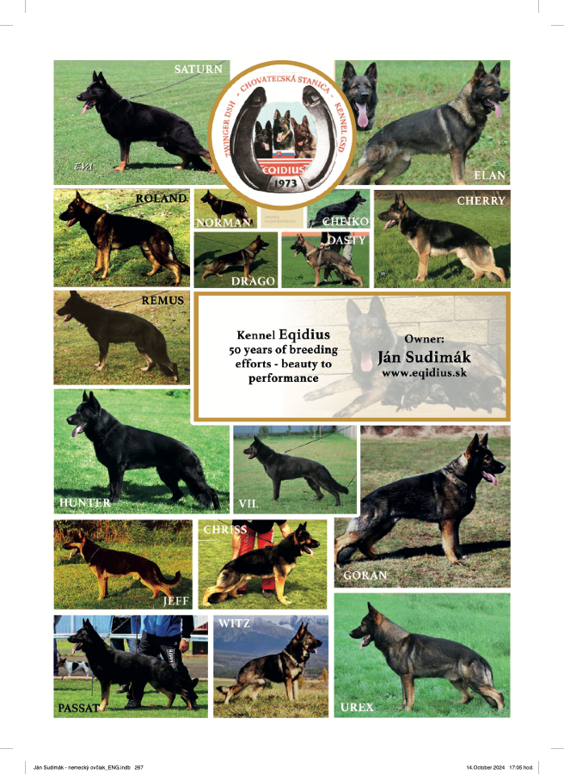
five decades of experience
EQIDIUS
50+ YEARS OF HARD-EARNED EXPERIENCE, distilled into one book
WHAT ALL THE GENERALS OF THE WORLD have failed to do, ONE BREED HAS ARCHIVED – to conquer the world
ALREADY READ ACROSS THE WORLD, NOW YOU CAN have it too

Slide 5
50+ YEARS OF HARD-EARNED EXPERIENCE, distilled into one book
WHAT WILL YOU discover INSIDE?
ALREADY READ ACROSS THE WORLD, NOW YOU CAN have it too

Slide 6
WHAT WILL YOU discover INSIDE?
ALREADY READ ACROSS THE WORLD, NOW YOU CAN have it too

Slide 7
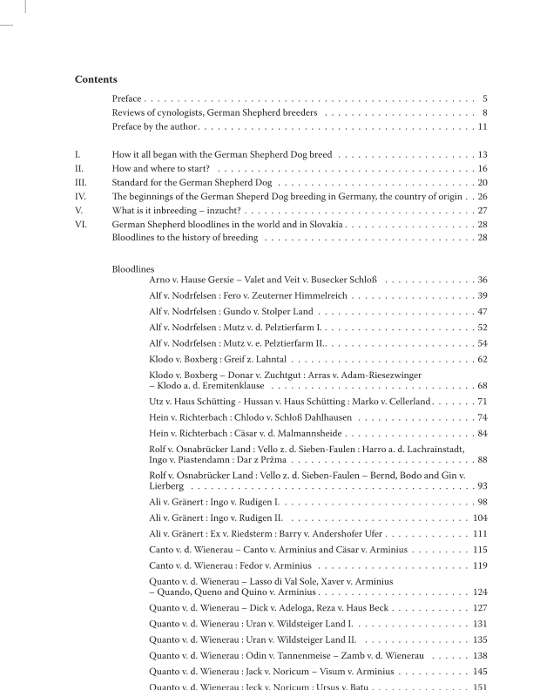
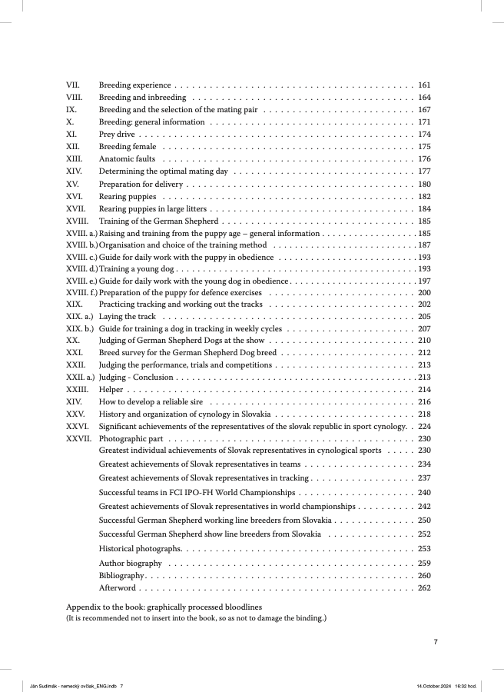

Slide 8
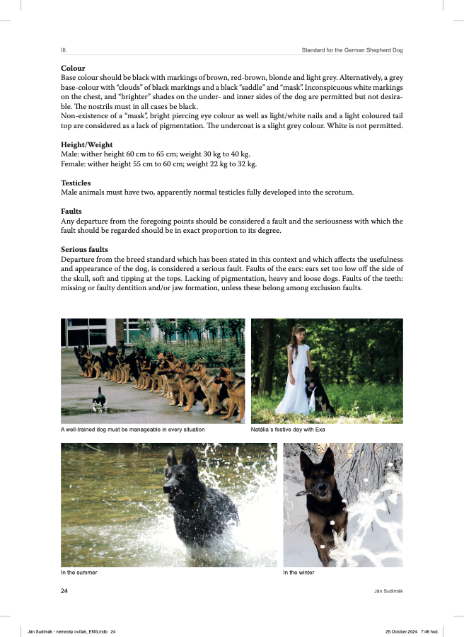
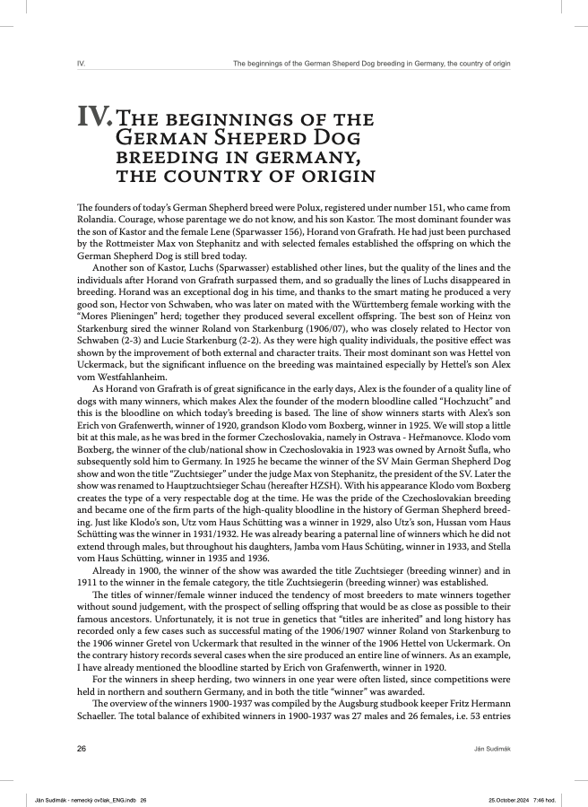

Slide 9
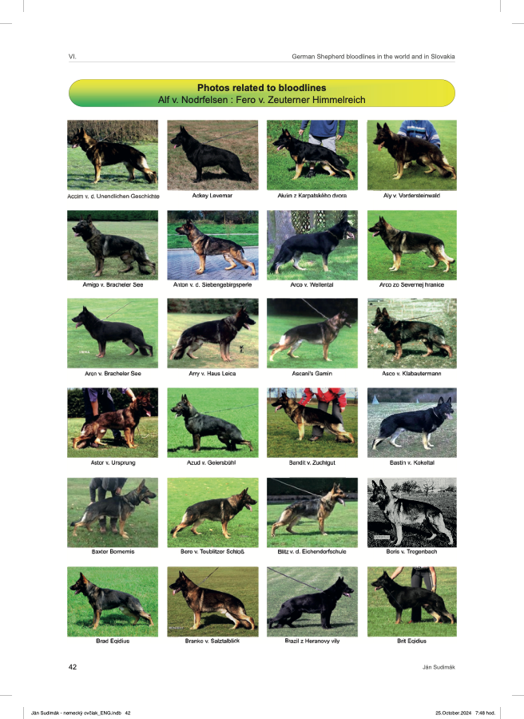
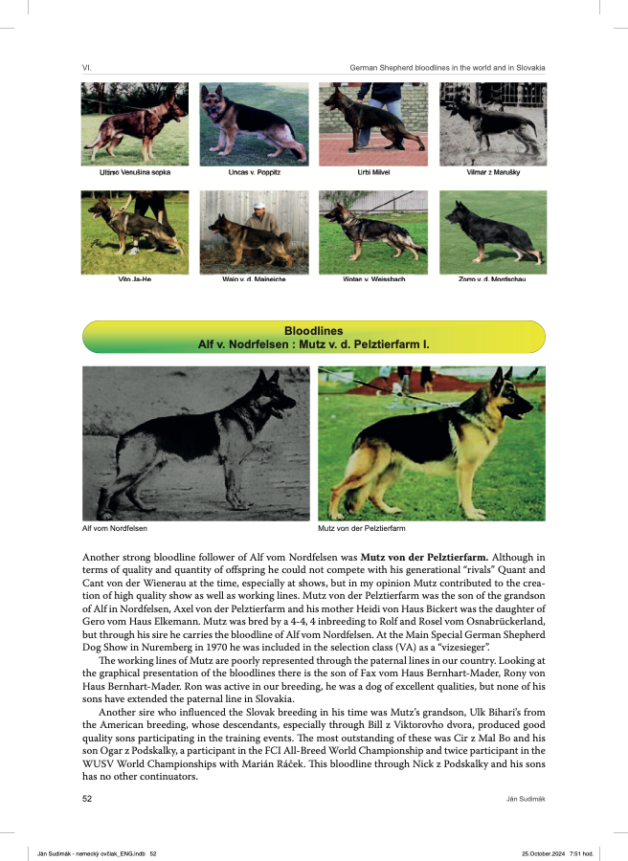

Slide 10
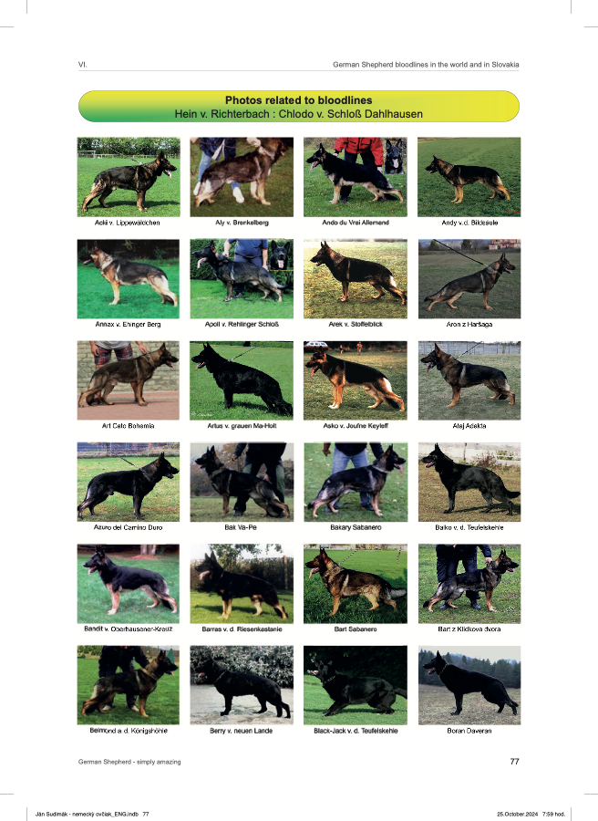
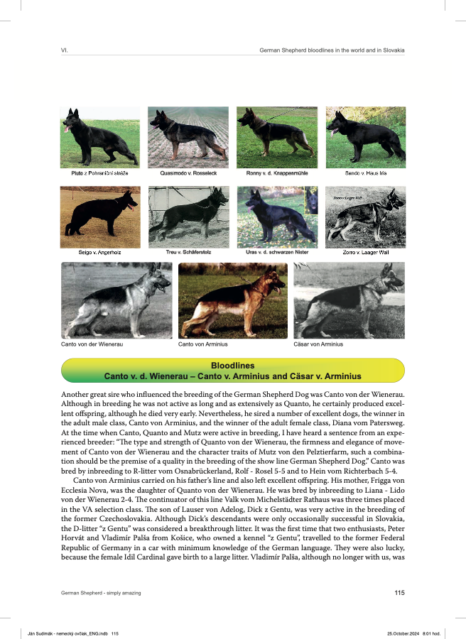

Slide 11
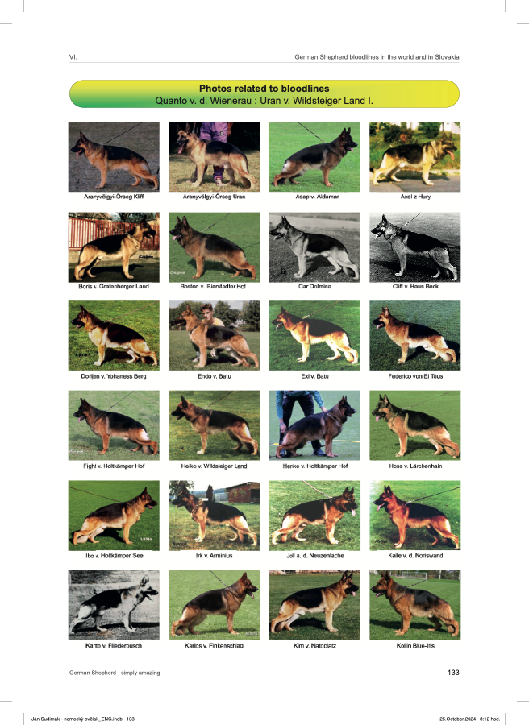
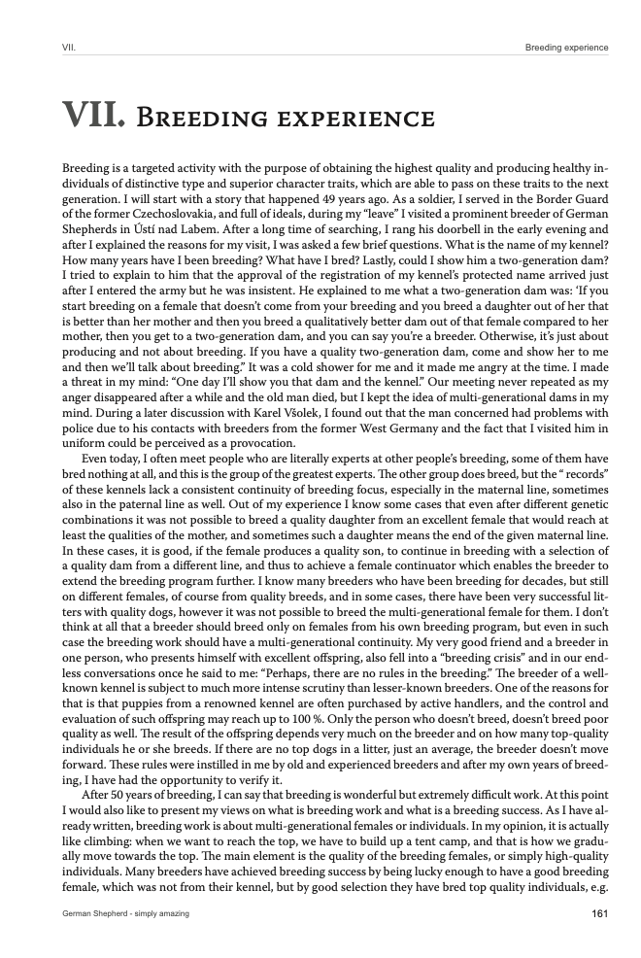
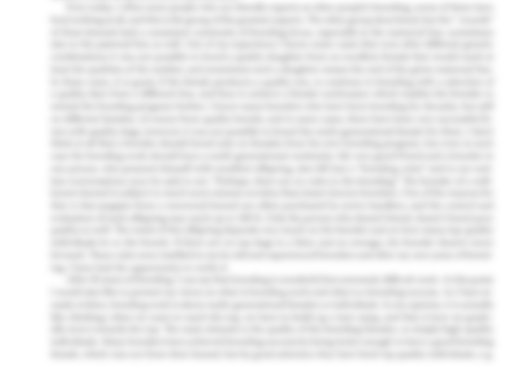

Slide 12
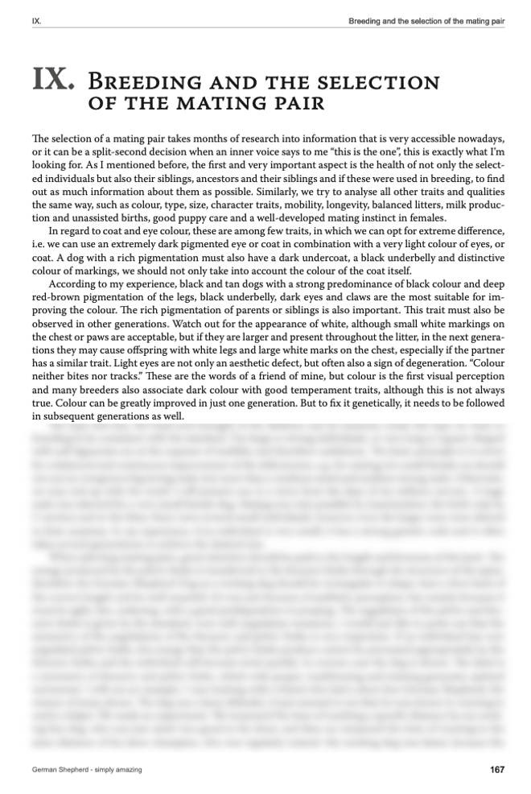
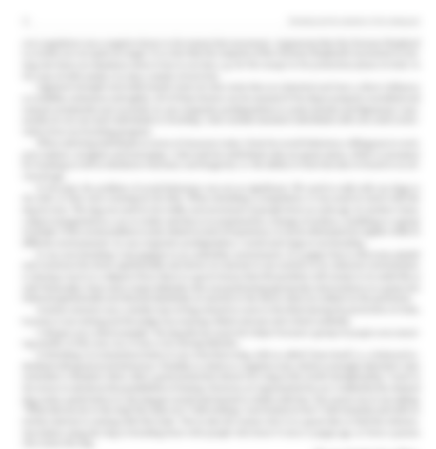
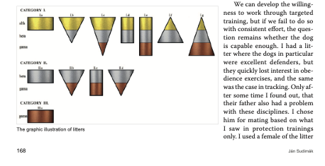

Slide 13
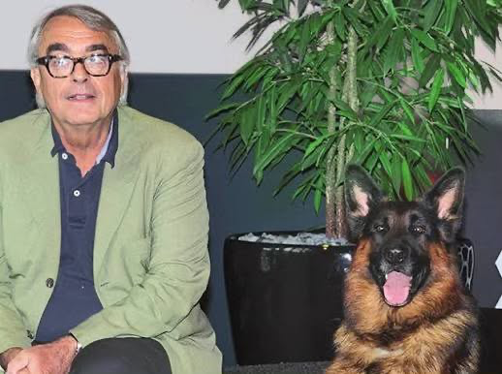
Dear Mr. Sudimák,
thank you very much for sending me your book “German Shepherd – Simply Amazing.” Please excuse my late response – only recently did I find the time to go through your work properly and with the attention it deserves.
I would like to sincerely congratulate you on this impressive publication. The combination of historical depth, clearly structured bloodline documentation, and the remarkable visual material makes this book far more than a classic photo collection. It is evident on every page that this work is the result of decades of practical experience, reflection, and genuine commitment to the German Shepherd Dog.
In my view, it is highly valuable that this book reaches an international audience. Especially today, when the breed is often discussed in a simplified or polarized way, your work offers a differentiated, factual, and experience-based perspective that is both refreshing and much needed.
Perhaps at some point it would be interesting to do a podcast interview or a similar format, to talk about your breeding philosophy, your long-term experiences, and the background to this book. I would personally enjoy such an exchange very much.
I would also greatly appreciate it if you could keep me informed about how the book is developing on the market and what further steps or projects may emerge from it.
Once again, my sincere compliments on this excellent work, and thank you very much for sending me a copy.
WHAT READERS say?
Prof. Dr.
HEINRICH MEßLER
LONGTIME PRESIDENT OF THE SV AND WUSV

Slide 14
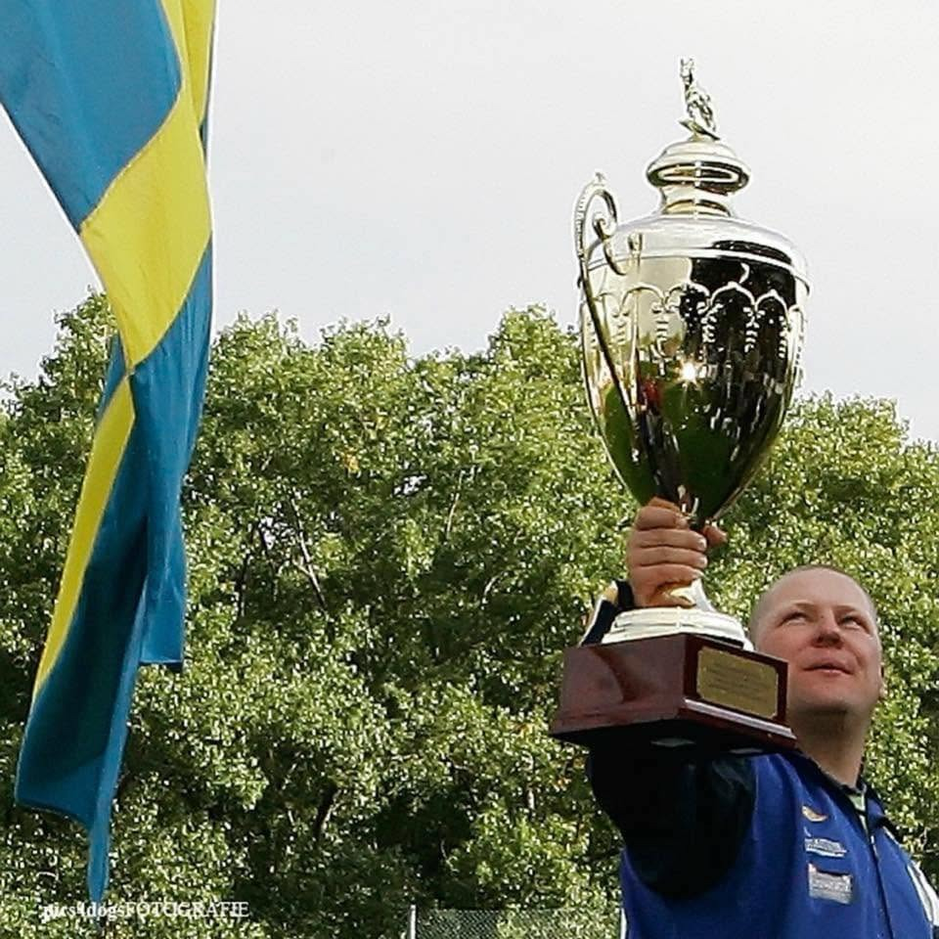
Dear Mr. Sudimák,
thank you very much for sending me your book “German Shepherd – Simply Amazing.” Please excuse my late response – only recently did I find the time to go through your work properly and with the attention it deserves.
I would like to sincerely congratulate you on this impressive publication. The combination of historical depth, clearly structured bloodline documentation, and the remarkable visual material makes this book far more than a classic photo collection. It is evident on every page that this work is the result of decades of practical experience, reflection, and genuine commitment to the German Shepherd Dog.
In my view, it is highly valuable that this book reaches an international audience. Especially today, when the breed is often discussed in a simplified or polarized way, your work offers a differentiated, factual, and experience-based perspective that is both refreshing and much needed.
Perhaps at some point it would be interesting to do a podcast interview or a similar format, to talk about your breeding philosophy, your long-term experiences, and the background to this book. I would personally enjoy such an exchange very much.
I would also greatly appreciate it if you could keep me informed about how the book is developing on the market and what further steps or projects may emerge from it.
Once again, my sincere compliments on this excellent work, and thank you very much for sending me a copy.
WHAT READERS say?
Prof. Dr.
HEINRICH MEßLER
LONGTIME PRESIDENT OF THE SV AND WUSV
This is a book that truly deserves to be called the German Shepherd Bible.
It is written with profound passion, knowledge, and understanding of the history of the German Shepherd Dog and its bloodlines.
This book is an absolute must-have for every serious and responsible German Shepherd breeder around the world.
I can wholeheartedly recommend this outstanding book , a book I proudly refer to as the Bible of the German Shepherd Dog.
PIERRE WAHLSTRÖM
IS A TOP-LEVEL TRAINER, BREEDER, AND INTERNATIONAL JUDGE, AS WELL AS A WUSV WORLD CHAMPION. HE IS ALSO A HIGHLY SUCCESSFUL BREEDER, HAVING BRED A FEMALE DOG THAT WON THE WUSV WORLD CHAMPIONSHIP

Slide 15

Dear Mr. Sudimák,
thank you very much for sending me your book “German Shepherd – Simply Amazing.” Please excuse my late response – only recently did I find the time to go through your work properly and with the attention it deserves.
I would like to sincerely congratulate you on this impressive publication. The combination of historical depth, clearly structured bloodline documentation, and the remarkable visual material makes this book far more than a classic photo collection. It is evident on every page that this work is the result of decades of practical experience, reflection, and genuine commitment to the German Shepherd Dog.
In my view, it is highly valuable that this book reaches an international audience. Especially today, when the breed is often discussed in a simplified or polarized way, your work offers a differentiated, factual, and experience-based perspective that is both refreshing and much needed.
Perhaps at some point it would be interesting to do a podcast interview or a similar format, to talk about your breeding philosophy, your long-term experiences, and the background to this book. I would personally enjoy such an exchange very much.
I would also greatly appreciate it if you could keep me informed about how the book is developing on the market and what further steps or projects may emerge from it.
Once again, my sincere compliments on this excellent work, and thank you very much for sending me a copy.
Prof. Dr.
HEINRICH MEßLER
LONGTIME PRESIDENT OF THE SV AND WUSV
This is a book that truly deserves to be called the German Shepherd Bible.
It is written with profound passion, knowledge, and understanding of the history of the German Shepherd Dog and its bloodlines.
This book is an absolute must-have for every serious and responsible German Shepherd breeder around the world.
I can wholeheartedly recommend this outstanding book , a book I proudly refer to as the Bible of the German Shepherd Dog.
PIERRE WAHLSTRÖM
IS A TOP-LEVEL TRAINER, BREEDER, AND INTERNATIONAL JUDGE, AS WELL AS A WUSV WORLD CHAMPION. HE IS ALSO A HIGHLY SUCCESSFUL BREEDER, HAVING BRED A FEMALE DOG THAT WON THE WUSV WORLD CHAMPIONSHIP
The book The German Shepherd Simply Amazing, written by author Jan Sudimák, Breeder from Kennel v Eqidius and Judge is a wonderful book for the enthusiast and breeder of our beloved breed. Beautifully written with photos and covering all facets, both beauty and training.
A solid reference work for breeders who wish to improve and preserve the breed. A beautiful book to have on your bookshelf.
JAN REDDER
PROFESSIONAL PHOTOGRAPHER AND GERMAN SHEPHERD BREEDER

Slide 16
This is a book that truly deserves to be called the German Shepherd Bible.
It is written with profound passion, knowledge, and understanding of the history of the German Shepherd Dog and its bloodlines.
This book is an absolute must-have for every serious and responsible German Shepherd breeder around the world.
I can wholeheartedly recommend this outstanding book , a book I proudly refer to as the Bible of the German Shepherd Dog.
PIERRE WAHLSTRÖM
IS A TOP-LEVEL TRAINER, BREEDER, AND INTERNATIONAL JUDGE, AS WELL AS A WUSV WORLD CHAMPION. HE IS ALSO A HIGHLY SUCCESSFUL BREEDER, HAVING BRED A FEMALE DOG THAT WON THE WUSV WORLD CHAMPIONSHIP
The book The German Shepherd Simply Amazing, written by author Jan Sudimák, Breeder from Kennel v Eqidius and Judge is a wonderful book for the enthusiast and breeder of our beloved breed. Beautifully written with photos and covering all facets, both beauty and training.
A solid reference work for breeders who wish to improve and preserve the breed. A beautiful book to have on your bookshelf.
WHAT READERS say?
JAN REDDER
PROFESSIONAL PHOTOGRAPHER AND GERMAN SHEPHERD BREEDER
WOULD YOU LIKE TO KNOW AN INTERESTING fact ABOUT
NIKÉ
EQIDIUS

Slide 17
The book The German Shepherd Simply Amazing, written by author Jan Sudimák, Breeder from Kennel v Eqidius and Judge is a wonderful book for the enthusiast and breeder of our beloved breed. Beautifully written with photos and covering all facets, both beauty and training.
A solid reference work for breeders who wish to improve and preserve the breed. A beautiful book to have on your bookshelf.
JAN REDDER
PROFESSIONAL PHOTOGRAPHER AND GERMAN SHEPHERD BREEDER
WOULD YOU LIKE TO KNOW AN INTERESTING fact ABOUT
NIKÉ
EQIDIUS

Slide 18
WOULD YOU LIKE TO KNOW AN INTERESTING fact ABOUT
NIKÉ
73 OF 119 DOGS AT THE WUSV
WORLD CHAMPIONSHIP
IN Nova Gorica
EQIDIUS

Slide 19
HAD MY KENNEL'S BLOODLINES
IN THEIR PEDIGREES —
up to 5 generations back
NIKÉ
73 OF 119 DOGS AT THE WUSV
WORLD CHAMPIONSHIP
IN Nova Gorica
EQIDIUS

Slide 20
16 DIFFERENT DOGS FROM MY KENNEL WERE IDENTIFIED,
WITH NIKÉ EQIDIUS APPEARING 56 times
HAD MY KENNEL'S BLOODLINES
IN THEIR PEDIGREES —
up to 5 generations back
73 OF 119 DOGS AT THE WUSV
WORLD CHAMPIONSHIP
IN Nova Gorica

Slide 21
16 DIFFERENT DOGS FROM MY KENNEL WERE IDENTIFIED,
WITH NIKÉ EQIDIUS APPEARING 56 times
HAD MY KENNEL'S BLOODLINES
IN THEIR PEDIGREES —
up to 5 generations back
LET‘S EXPLORE THE Bloodlines

Slide 22
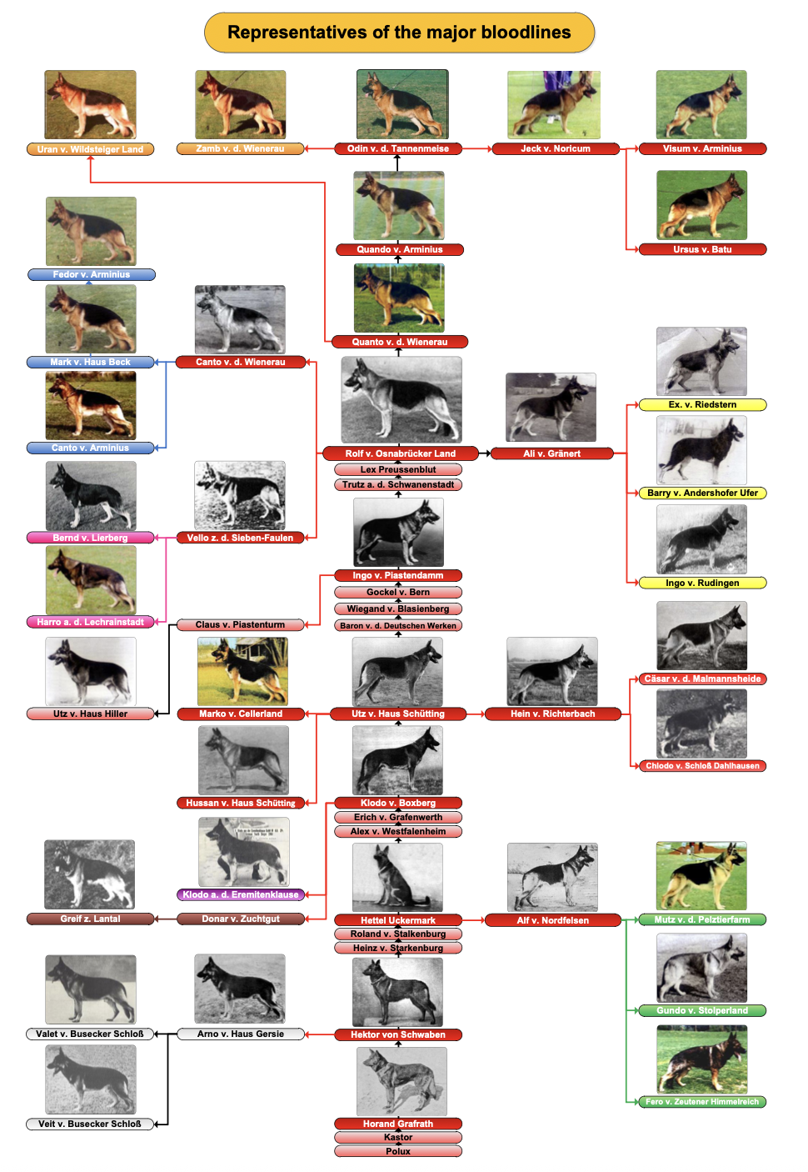
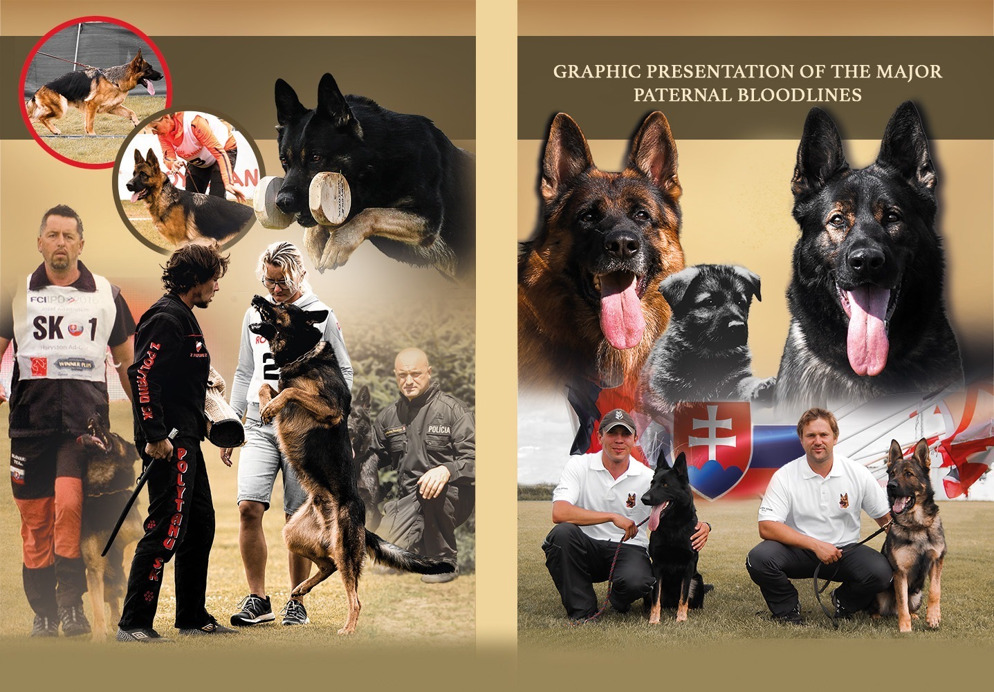
16 DIFFERENT DOGS FROM MY KENNEL WERE IDENTIFIED,
WITH NIKÉ EQIDIUS APPEARING 56 times
LET‘S EXPLORE THE Bloodlines

Slide 23
LET‘S EXPLORE THE Bloodlines

Slide 28
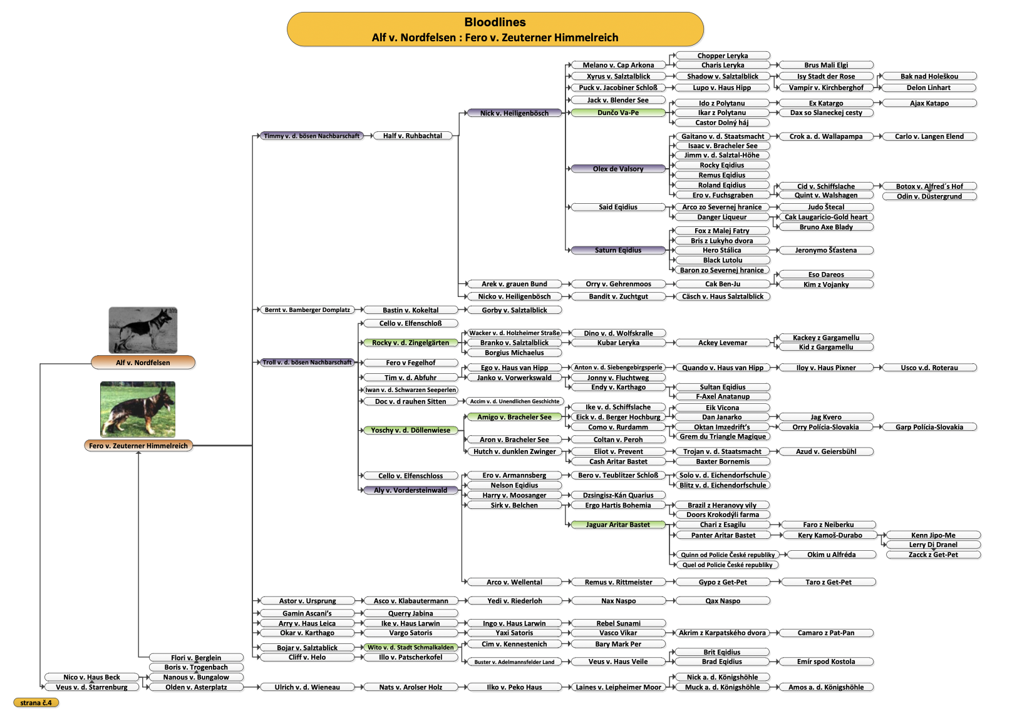

Slide 30
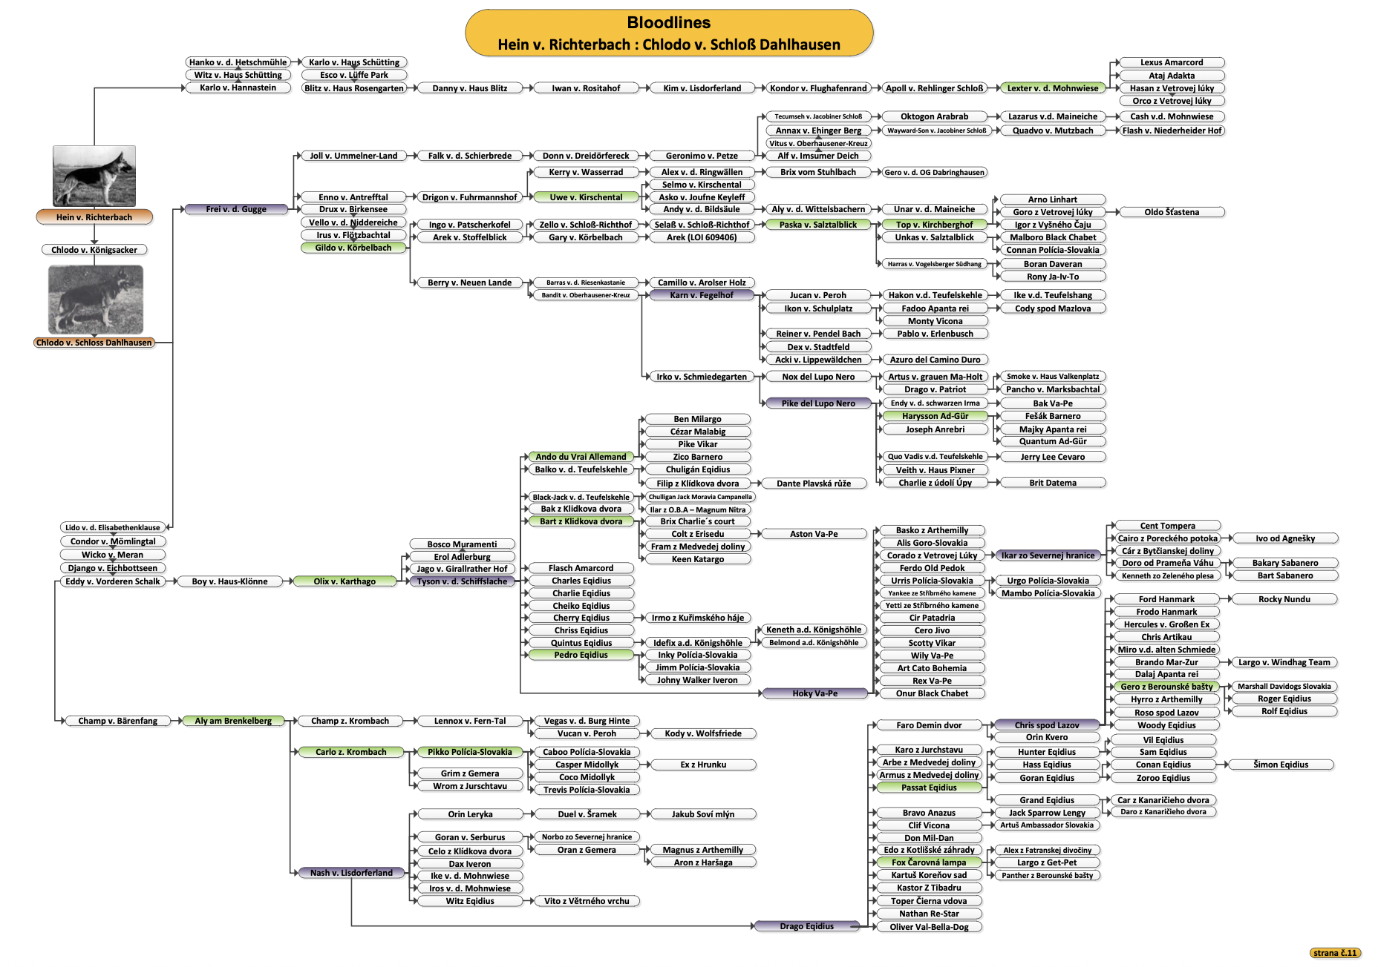

Slide 32
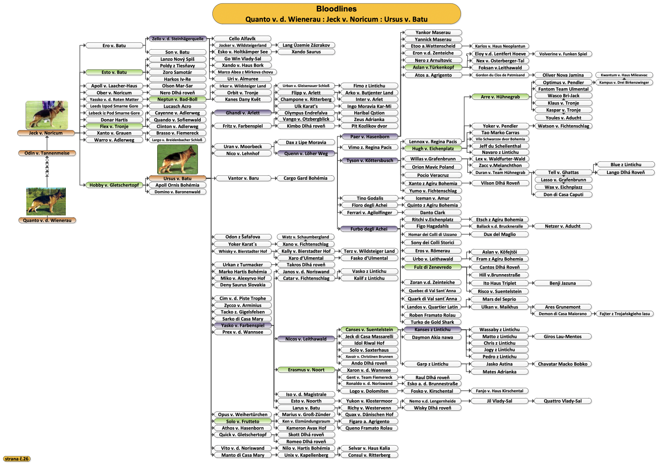

Slide 34
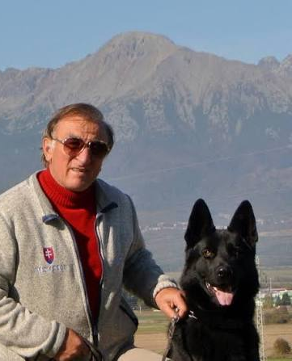
FINAL 400 COPIES
NO REPRINTS.
Ever.

Slide 35
FINAL 400 COPIES
NO REPRINTS.
Ever.
IS THIS BOOK for you?

Slide 36
FINAL 400 COPIES
NO REPRINTS.
Ever.
IS THIS BOOK for you?
IF YOU THINK THE
German Shepherd is simply amazing

Slide 37
then yes
IS THIS BOOK for you?
IF YOU THINK THE
German Shepherd is simply amazing

Slide 38
Made for those who understand German Shepherds.
Get yours today.
Visit our e-shop.
then yes
IF YOU THINK THE
German Shepherd is simply amazing

Slide 39
Made for those who understand German Shepherds.
Get yours today.
Visit our e-shop.
then yes
FOR MORE INFORMATION
https://www.jansudimakbook.com/en/
CLICK ON THE LINK

Slide 40
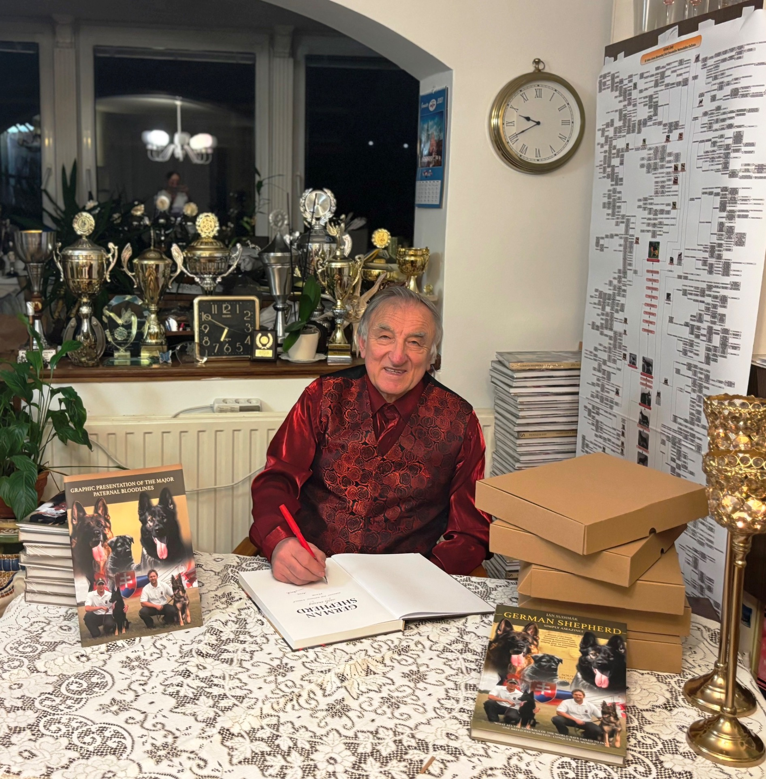
My name is Ján Sudimák, and I am a German Shepherd breeder, international conformation and performance judge, breed survey commissioner, and founder of the world-renowned Eqidius kennel. For more than 50 years, I have dedicated my life to breeding, training, evaluating, and understanding this extraordinary breed.
Through this unique publication, I share a lifetime of experience and knowledge gained over decades of hands-on work with German Shepherds. In this book, I explore the breed’s history, present some of the most influential bloodlines in the world, and offer practical insights into breeding, puppy rearing, training, and the principles that have guided my work throughout my career.
Made for those who understand German Shepherds.
Get yours today.
Visit our e-shop.
then yes
FOR MORE INFORMATION
https://www.jansudimakbook.com/en/
CLICK ON THE LINK

Slide 41
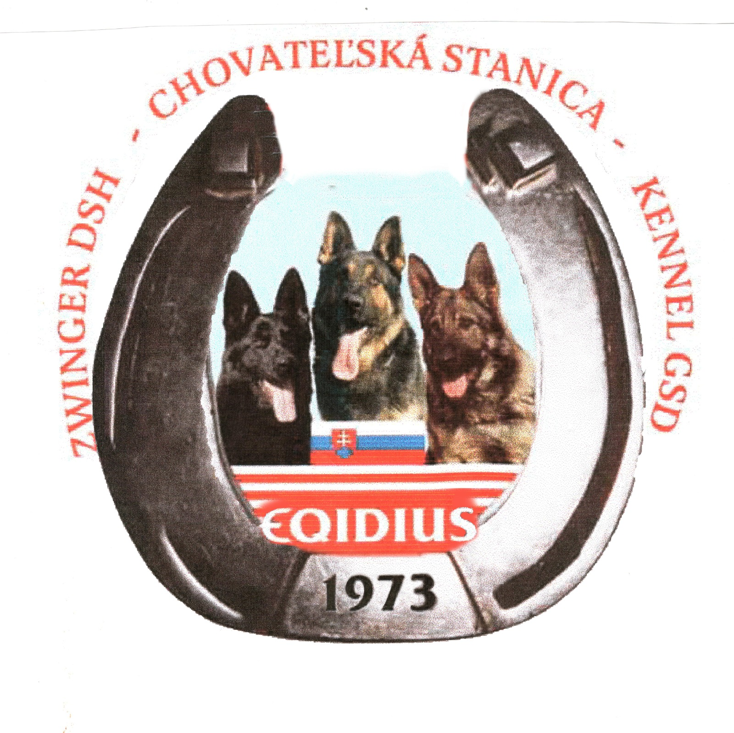
THANK YOU FOR CELEBRATING 50 YEARS OF DEDICATION
TO German Shepherds WITH US
My name is Ján Sudimák, and I am a German Shepherd breeder, international conformation and performance judge, breed survey commissioner, and founder of the world-renowned Eqidius kennel. For more than 50 years, I have dedicated my life to breeding, training, evaluating, and understanding this extraordinary breed.
Through this unique publication, I share a lifetime of experience and knowledge gained over decades of hands-on work with German Shepherds. In this book, I explore the breed’s history, present some of the most influential bloodlines in the world, and offer practical insights into breeding, puppy rearing, training, and the principles that have guided my work throughout my career.
FOR MORE INFORMATION
https://www.jansudimakbook.com/en/
CLICK ON THE LINK

Slide 42
My name is Ján Sudimák, and I am a German Shepherd breeder, international conformation and performance judge, breed survey commissioner, and founder of the world-renowned Eqidius kennel. For more than 50 years, I have dedicated my life to breeding, training, evaluating, and understanding this extraordinary breed.
Through this unique publication, I share a lifetime of experience and knowledge gained over decades of hands-on work with German Shepherds. In this book, I explore the breed’s history, present some of the most influential bloodlines in the world, and offer practical insights into breeding, puppy rearing, training, and the principles that have guided my work throughout my career.
THANK YOU FOR CELEBRATING 50 YEARS OF DEDICATION
TO German Shepherds WITH US

